Slide 1

CSA0303 DATA STRUCTURE
M.VISHAL
192511244

Slide 2

Music Streaming Application
Problem Statement
Music streaming applications manage dynamic playlists.
Users can add, remove, and reorder songs.
Users can navigate to the next or previous song.
The data structure should support frequent updates efficiently.

Slide 3
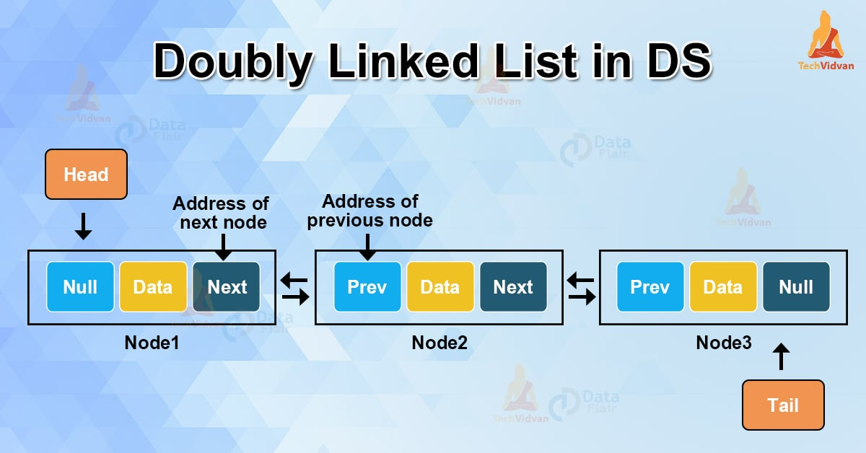
Recommended Data Structure
Doubly Linked List
Stores each song as a node.
Each node has links to the previous and next songs.
Allows easy insertion and deletion.
Supports bidirectional navigation.

Slide 4
Justification & Performance
Insert Song – O(1)
Delete Song – O(1)
Search Song – O(n)
Previous/Next Song – O(1)
Conclusion: Doubly Linked List is the best choice because it offers flexibility and efficient playlist management.

Slide 5
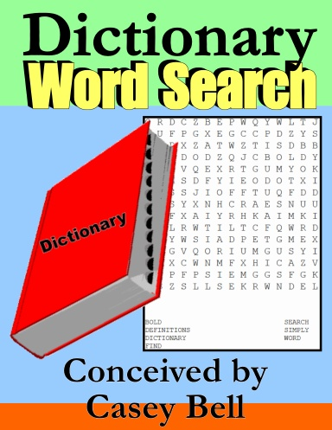
Dictionary Word Search
Problem Statement
A dictionary stores millions of words.
Users need instant word search.
It should support auto-complete and spell checking.
Search performance is the primary requirement.

Slide 6
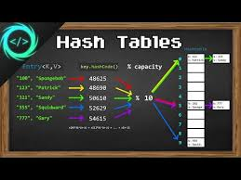
Recommended Data Structure
Recommended Data Structure — Hash Table
Stores words using hash functions.
Uses key-value or key-based storage.
Average search time: O(1).
Very efficient for exact word existence checks.

Slide 7
Advantages & Conclusion
Extremely fast average lookup.
Efficient insertion and deletion.
Suitable for large word databases.
Limitation: Hash collisions can occur.
Conclusion: Hash Table is an excellent choice for fast dictionary word searches.

Slide 8

Task Scheduling System
Problem & Requirements
Jobs have different priority levels.
The highest-priority job should execute first.
New tasks can arrive dynamically.
The system needs efficient priority management.

Slide 9
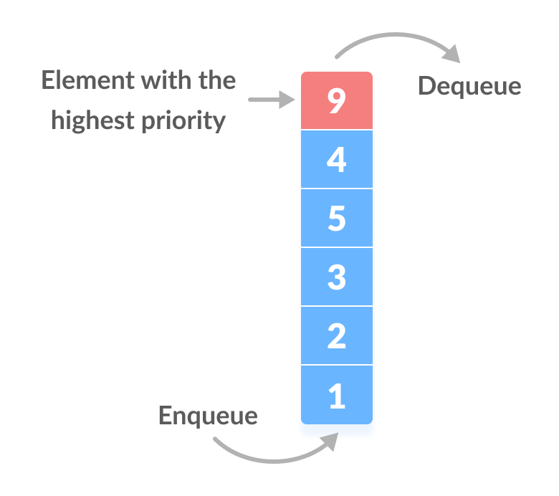
Priority Queue (Heap)
Recommended Data Structure — Priority Queue (Heap)
Maintains tasks according to priority.
A Max Heap can execute the highest-priority task first.
Insert task: O(log n).
Remove highest-priority task: O(log n).
Access highest priority: O(1).

Slide 10
Advantages & Conclusion
Efficient priority-based scheduling.
Handles dynamic task insertion.
Quickly identifies the next task to execute.
Suitable for operating systems and job scheduling.
Conclusion: Priority Queue implemented using a Heap is an efficient solution for priority-based task scheduling.

Slide 11
THANK YOU

